Slide 1
DM TA Session 2
Hanwen Serena Xu
hanwen@uchicago.edu

Slide 2
Contents
KMeans
DBSCAN
Questions

Slide 3
K-Means
A simple and common algorithm capable of clustering data very quickly and efficiently
Proposed by Stuart Lloyd in 1957; it was only published outside of the company in 1982
Have to specify the number of clusters k that the algorithm must find
Each cluster is represented by its center (i.e, centroid) which corresponds to the mean of the observation values assigned to the cluster
Basic idea - constructing clusters so that the total within-cluster variation is minimized

Slide 4
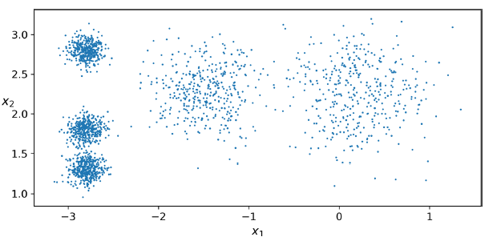
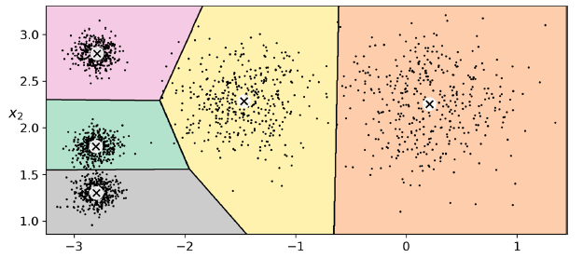
K-Means
Original data plot
Ideal result

Slide 5
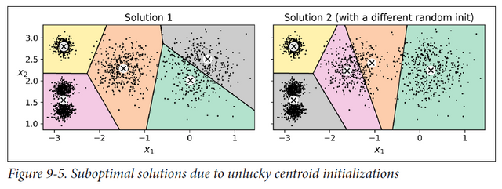
K-Means
Although the algorithm is guaranteed to converge, it may not converge to the right solution (i.e., it may converge to a local optimum)
Whether it does or not depends on the centroid initialization

Slide 6
How to choose # of clusters?
Elbow Method
Silhouette Analysis

Slide 7
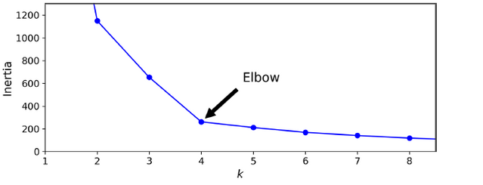
Elbow Method
The mean squared distance between each instance and its closest centroid
We use how much the inertia dropped as the performance metric to choose k

Slide 8
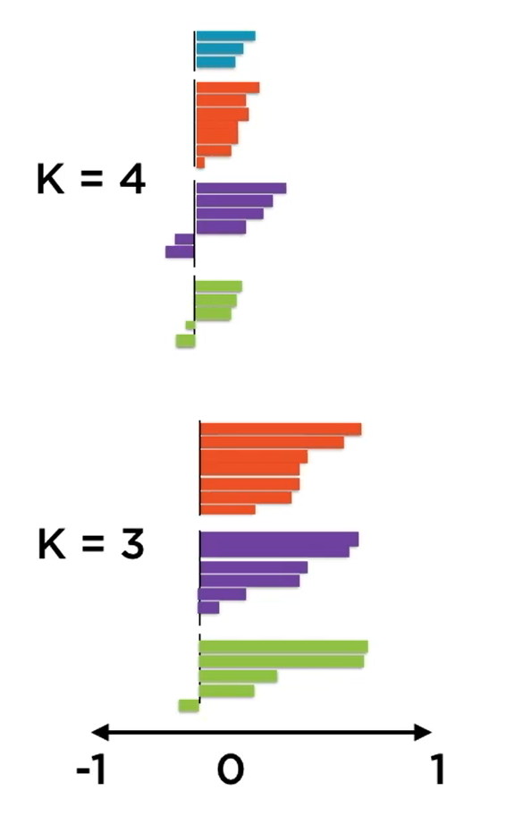
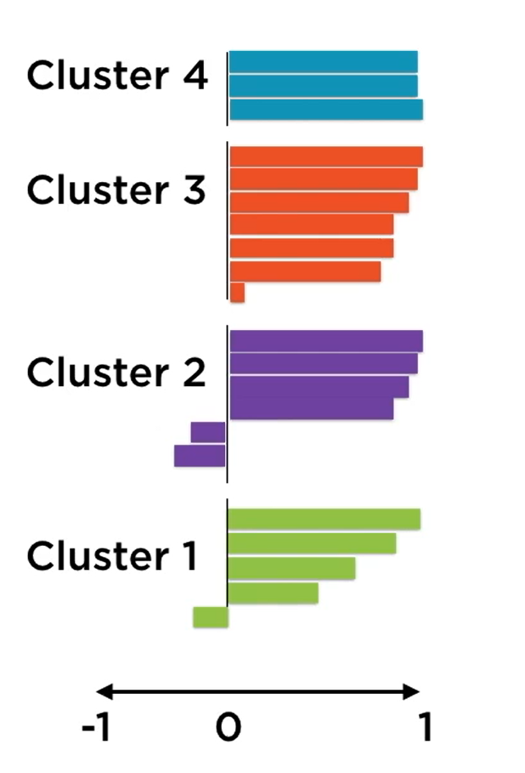
Silhouette Analysis

Slide 9
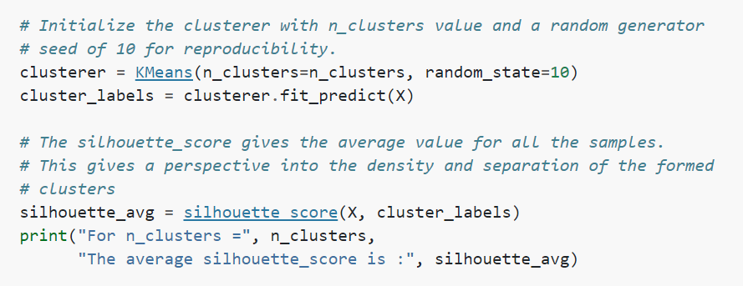
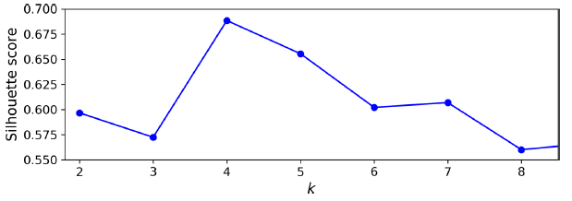
Silhouette Analysis
It confirms that k = 4 is a very good choice, and it also underlines the fact that k = 5 is quite good as well, and much better than k = 6 or 7
This was not visible when comparing inertias

Slide 10
How to choose # of clusters?
Try different approaches (Elbow method, Silhouette Score)
Applications requiring the exact optimal set of clusters is fairly rare
Ideally you need to understand data or work with an industry expert

Slide 11
Questions about K-Means?

Slide 12
BDSCAN
DBSCAN is a very simple yet powerful algorithm capable of identifying any number of clusters of any shape
It is robust to outliers, and it has just two hyperparameters (eps and min_samples)

Slide 13
How to choose hyperparameters
Source:
https://www.aaai.org/Papers/KDD/1996/KDD96-037.pdf
https://www.ccs.neu.edu/home/vip/teach/DMcourse/2_cluster_EM_mixt/notes_slides/revisitofrevisitDBSCAN.pdf
https://iopscience.iop.org/article/10.1088/1755-1315/31/1/012012/pdf

Slide 14
How to choose min_samples?
Min_samples is best set by a domain expert who understands the data well.
If not:
For 2-dimensional data, authors of DBSCAN suggest 4
If your data has more than 2 dimensions, choose MinPts = 2*dim
Sometimes we also use ln(n). Min_samples >=3

Slide 15


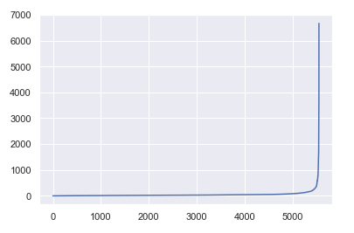
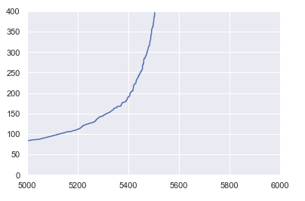
How to choose eps?
After choosing min_samples

Slide 16
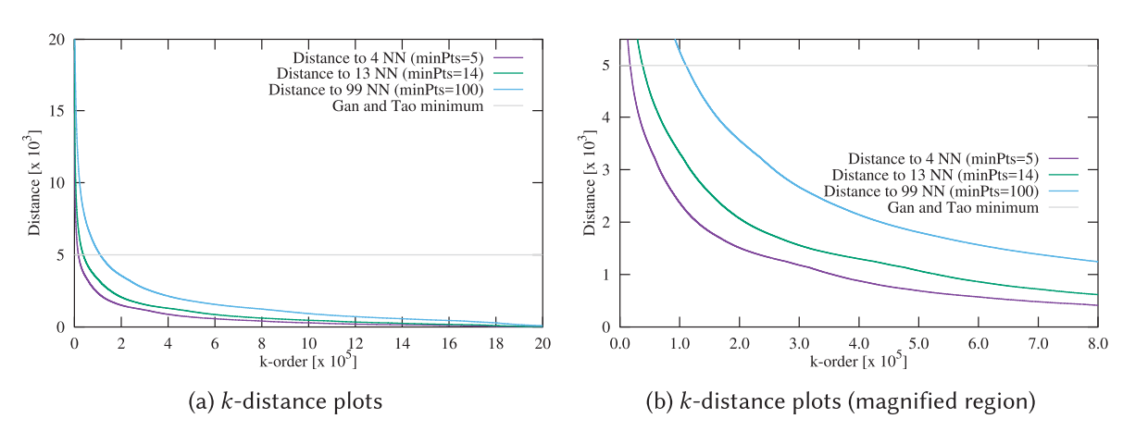
How to choose eps?
Be consistent in min_samples

Slide 17
Questions about DBSCAN?

Slide 18
Recommended sources
Hands-On Machine Learning with R (Boehmke & Greenwell)
Hands-On Machine Learning with Scikit-Learn, Keras, and TensorFlow: Concepts, Tools, and Techniques to Build Intelligent Systems (Geron)
Applied Predictive Modeling (Johnson & Kuhn)
An Introduction to Statistical Learning: With Applications in R (James et al.)
Business Data Science: Combining Machine Learning and Economics to Optimize, Automate, and Accelerate Business Decisions (Taddy)
The Hundred-Page Machine Learning Book (Burkov)

